Slide 2
Os Desafios das Redes Ethernet de Transporte

Slide 3

O Estado do Mercado Carrier Ethernet
A banda larga é o grande desafio de infraestrutura
100 milhões de residências (US) com 100Mbps na próxima década
Os provedores já estão com problemas para suportar a demanda de tráfego atual
90% de residências (US) com acesso banda larga em 2020
Usuários de TV via internet triplicou desde 2006
Mais de 1bilhão de usuários de banda larga até 2013
Carriers Converging Multiple Services on Common Ethernet Transport Networks Must Monetize their Networks to Survive, Compete & Thrive
Notes:
SP world the NMS is very very important. Yes, we have cutting edge platforms but SP’s tend to look for great SOLUTIONS, not just excellent NE.
With RSA we have a great top-down SP solution.

Slide 4
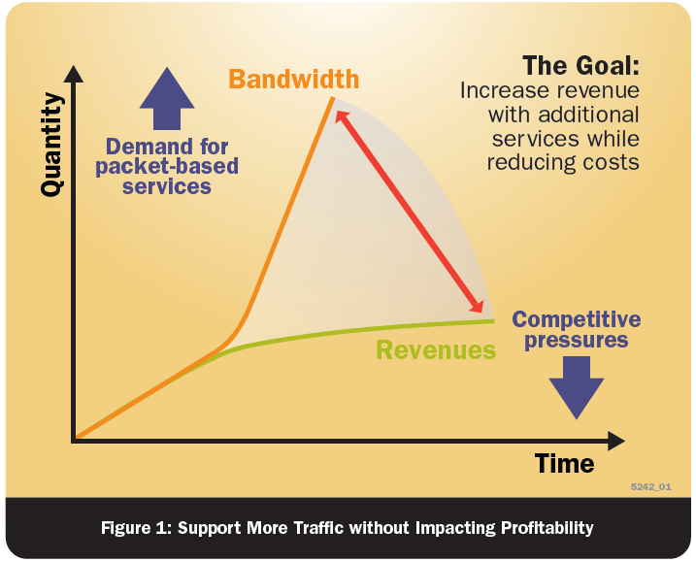

Suportar mais Tráfego – Aumentar Lucros
Increase the Service Flexibility
Deliver more Service Versatility
Change to quicker Service Roll Out
Allow quicker Service Changes
Orientation on Customer Demands
Challenges
REDUCE
CAPEX
REDUCE
OPEX
INCREASE
ARPU/APPU
ARPU: Average Revenue Per User
APPU: Average Productivity Per User
Notes:
Page 4

Slide 5




Arquitetura Padronizada MEF
E-Line Service
E-Line Service used to create
  P2P VPN Services
  Ethernet Private Lines
  Ethernet Internet Access
  Leased Line Replacements
CE
PE
Carrier Ethernet Network
PE
CE
Point-to-Point EVC
E-LAN Service
E-LAN Service used to create
  Multipoint L2 VPNs
  Transparent LAN Service
  IPTV and Multicast networks
  VoIP networks
  Gaming domains
CE
PE
CE
PE
PE
CE
PE
PE
Carrier Ethernet Network
CE
Multipoint-to-Multipoint EVC
E-Tree Service
Ethernet Tree used to create
  Service offering to residential Users
    Public internet services
    Provider services i.e. VoIP, BTTV, IPTV…
  Multicast environments
  Centralized services for data centers ect.
PE
CE
CE
PE
Carrier Ethernet Network
CE
Tree Root
PE
Notes:
Our solution today
High Service Density – Hierarchical QoS, VMAN Cross-Connect,
Scale – MAC in MAC, VPLS, Ethernet ping and traceroute
Availability – XOS, EAPS, redundant MSM

Slide 6
Quais são os Desafios ?
Provisionamento de Serviço
Configuração dinâmica de circuitos
Convergência automática de caminhos
Alocação dinâmica de banda
Transporte de tráfego síncrono
E1 e Mobile backhaul
Regeneração de clock em redes ethernet
Custo por byte trafegado
Tráfego cresce em progressão geométrica, receita em progressão aritmética
Notes:
Page 6

Slide 7
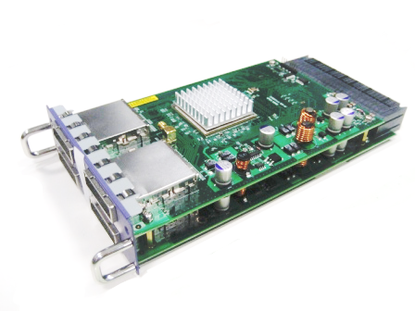
Custo por byte – Interface 40Gbps
40G full duplex connection
40 Gbps
40 Gbps
  Demonstrada na Interop no início do mês
  $ Menos de U$1000 por porta
  Disponível para X650/X480

Slide 8
Mobile Backhaul – Drivers of Change
Source: Analysys Mason, 2009
  O tráfego de banda larga móvel gera um volume maior do que o suportado de maneira eficiente pelas redes legadas

Slide 9
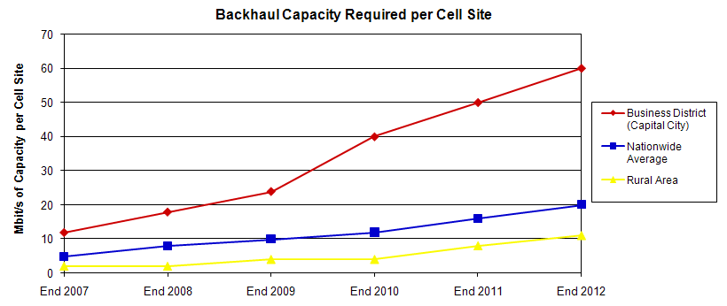
Mobile Backhaul – Drivers of Change
Source: Heavy Reading, 2008

Slide 10
Desafios com Ethernet-Based Backhaul
SLA Requirements – Service Assurance
 | Business VPN | Mobile Backhaul | Residential Triple Play
Latency | 10-55ms | 5-25 ms | 100 ms
Jitter | 5-10ms | 2-10ms | 5-10 ms
Packet Loss | .05% | .05% | .05%
Class of Service | 4 levels | 2 CoS Levels | 4 levels
Protection Switching | <50ms | <50ms | <50 ms
Availability | 5 nines | 5 nines | 5 nines
MTTR | 4 hours | 4 hours | 4 hours
  Redes GSM e CDMA usam tecnologia FDD que necessita de sincronismo de clock
  Ethernet nativamente não possui nenhum mecanismo de distribuição de clock

Slide 11
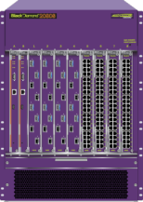






MEF.22 - Mobile Backhaul Implementation Agreement
Precision Clock Solutions
MEF.22 Compliant
BlackDiamond® 20808
MEF.9, .14 Compliant
Key Features
  Superior bandwidth capacity with 64 line-rate 10 GbE ports available in compact 14 RU form factor
TimeProvider 5000
  Central Site PTP/IEEE 1588v2 server solution over standard Ethernet
  GPS Antenna option
  Primary and secondary input E1 reference clocks
  Rubidium and/or quartz oscillators
TimeProvider 500
  Remote site PTP/IEEE 1588v2 client solution over standard Ethernet
  E1/T1 compliant clock outputs
Summit X480
Key Features
  Feature rich, cost/benefit, 1/10G Metro Aggregation and Data Center Top-of-rack
TimeProvider 5000 IEEE 1588-2008 Grandmaster Clock
TimeProvider 500

Slide 12
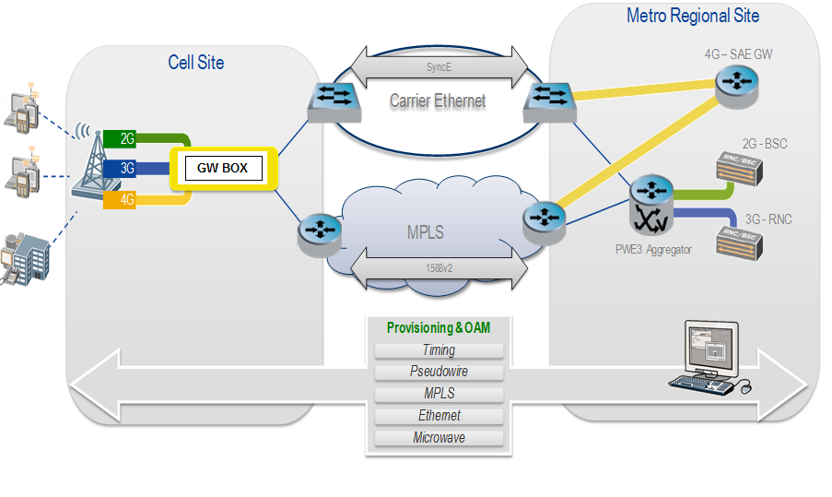
Topologia – Ethernet Mobile Backhaul

Slide 13

Provisionamento de Serviços em VPLS
X-Connect
VPLS/HVPLS Core (FRR)
backup path
primary path
vMAN
vMAN
VLAN
VLAN
Provisionamento dinâmico de serviço
Alocação dinâmica de banda
Escolha automática de melhor caminho
Ainda necessita de complexo esquema de TE

Slide 14
Provisionamento de Serviços - Modelo L2 Tradicional
EAPS ou Ring Converg. Protocol
backup path
primary path
vMAN
vMAN
VLAN
VLAN
Provisionamento de serviço manual
Reserva de banda configurada manualmente
Caminhos redundantes previamente escolhidos e configurados

Slide 15



Extreme OAM Stack
ITU-T Y.1731
Edge-edge Performance measurement
Frame Loss, Delay, Jitter, Throughput
Use CCMs with addl TLVs
Edge-edge Connection Management
CCM, LBM, LTR
IEEE 802.1ag
Pt – Pt Link Management
LFM, RFI, RLB
IEEE 802.3ah
802.3ah
Link Level OAM
802.1ag Connectivity Fault Mgmt
Y.1731 Ethernet Service and Performance Monitoring
802.3ah
Discovery of OAM between Devices
Link Monitoring
Remote Fault Indication
Remote LoopBack
Last Dying Gasp
Critical Event Notification
802.1ag
Continuity Check Messages
MAC Ping
MAC Trace Route
Multiple Administrative Domain
Y.1731
Fault Management
Diagnostics
Performance Monitoring
Loss/Jitter/Delay Measurements
AIS/RDI notification

Slide 16
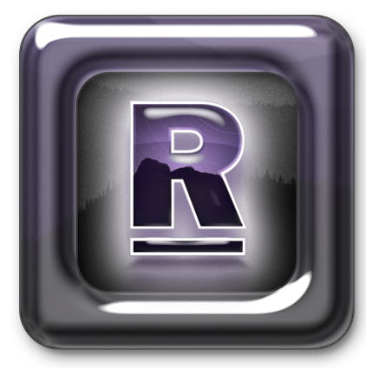
Ridgeline® Service Advisor
Monetize
Control
Visualize

Slide 17
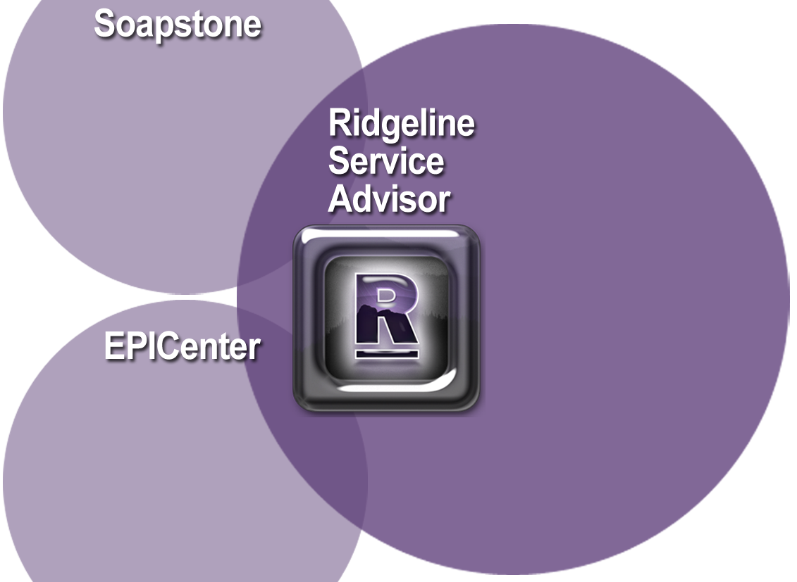
Introducing Ridgeline Service Advisor
Point-and-click provisioning model
Service management model (E-LAN & E-Line)
Service path visualization
Fault to service correlation
CAC
Resource allocation model
Interoperability framework
Point-and-click provisioning model
Service management model (E-LAN & E-Line)
Service path visualization
Fault to service correlation
CAC
Resource allocation model
Interoperability framework
Scripting
Network visualization and monitoring
Statistics and reports
GUI
Fault management
Inventory, software and configuration management
Secure communication
Role based access
Scripting
Network visualization and monitoring
Statistics and reports
GUI
Fault management
Inventory, software and configuration management
Secure communication
Role based access
Notes:
Synergistic approach makes combined product very attractive.
Shorter time to market.
Differentiator for our SP solution.

Slide 18








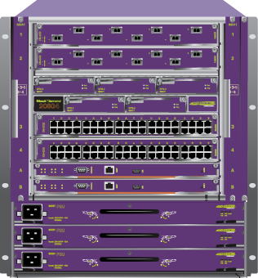

Ridgeline Enables Pro-Active Service Management
Subscriber
Ethernet Access and Aggregation Network
Metro Core
Ridgeline Service Advisor
Summit ® X480
Black Diamond ®
Triple Play
10 GE
20808
Mobile
Backhaul
Summit X480
10 GE
BlackDiamond 20804
Business Ethernet
ExtremeXOS® Operating System
Wholesale
Requirements:
Ridgeline Benefits:

Accelerate Revenue with Point-and-Click Provisioning
Service Fulfillment:
Service Assurance:

Improve Subscriber Loyalty with Pro-Active Service Management
Service Engineering

Increase Network Efficiency with Simplified Traffic Engineering
Notes:
How we do it.
Make it simple: Point and click
Make them stay: Assuring the service
Engineer the network correctly in order to maximise revenue.
Extreme Networks Confidential and Proprietary. © 2008 Extreme Networks Inc. All rights reserved.
18

Slide 19

What is Service Management?
Service Management
Service Provisioning
Service Visualization
Service Monitoring
Service
Management
Network Management
Transport Provisioning
Physical Visualization
Transport Visualization
Transport Monitoring
Troubleshooting
Network
Management
Ridgeline Service Advisor
Element Management
Inventory
Fault Management
Statistics and Reporting
Element
Management
Ridgeline Service Advisor Combines Service Management with Network and Element Management
Notes:
Complete integrated solution.
Service/Network/Element mgr all in a single platform

Slide 20
Ridgeline Service Advisor
Pricing and Availability
  Targeted ability 3Q 2010
  US list pricing starts at $19,995 for 20 nodes
Notes:
Simple pricing structure – pay as you grow.
+50 pack
+250 pack
Special feature pack PBB/VPLS
Annual maintenance and subscription charge – All updates and fixes plus access to 24 hour TAC.

Slide 21
Hardware Overview
and conclusion

Slide 22



Carrier Ethernet Transport Portfolio
MEF Certified Solutions
Ridgeline Service Advisor
Ethernet Access Central Offices
Ethernet Aggregation Central Offices
Metro Core Central Office
Summit ® X650
BlackDiamond®
20804
BlackDiamond
20808
Up to 32 x10 GE
Summit X450/X480
24 or 48xGE Access,
4x 10 GE Up
Summit X250e
32 x Line-Rate 10 GE
Summit X480
24 or 48 x10/100 E, 2x GE Up
64 x Line-Rate 10 GE
100GE Ready
24 or 48xGE Access,
4x 10 GE Up
ExtremeXOS® Operating System
Ridgeline Service Advisor the Latest Addition to the Extreme Networks Service Provider Portfolio
Notes:
Part of our portfolio
Excellent fit
Consistent
Releases will more or less coincide with XOS release – twice a year. One XOS – one RSA.

Slide 23
Thank You

